Slide 1
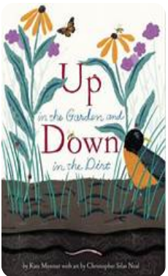
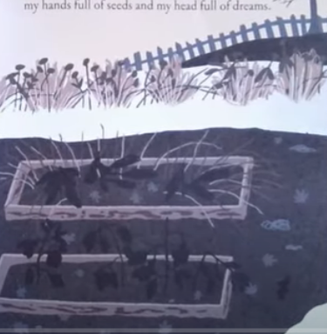
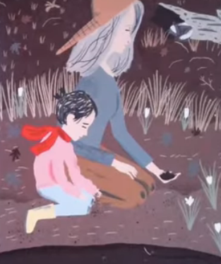
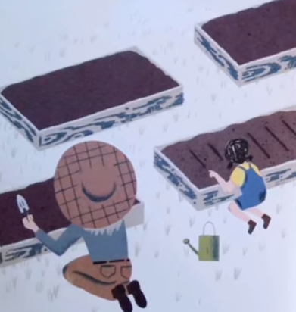
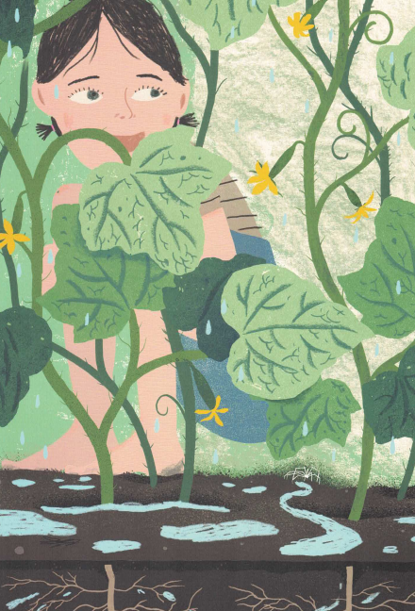
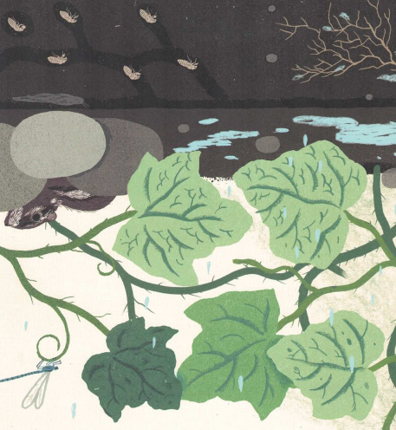
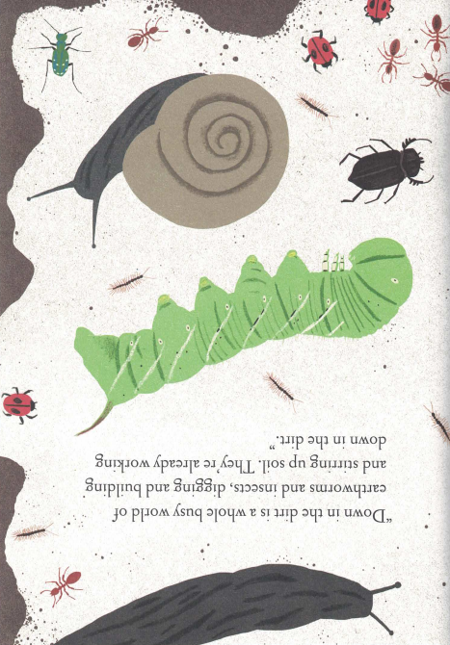
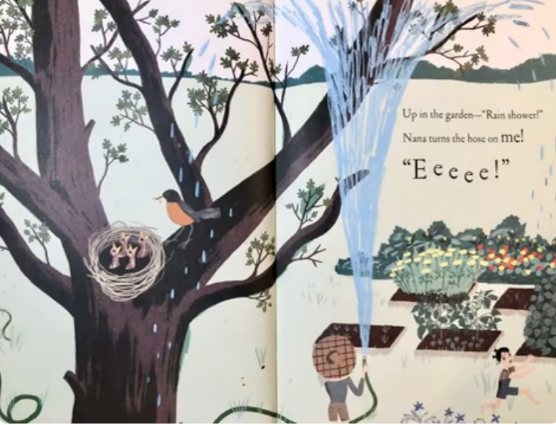
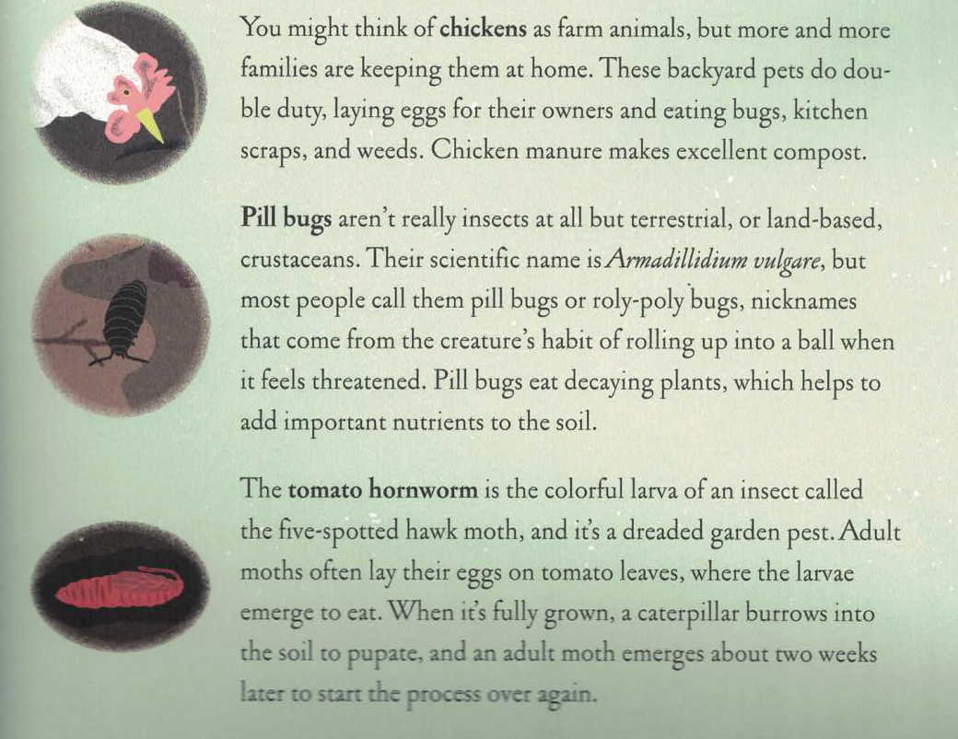
This book by Kate Messner explores the garden from early spring through the four seasons ending with winter. Each season explores the changes that take place in the sky, on the land, and under the ground. Along the way, we discover that everything has a purpose and a part in a garden.
https://youtu.be/CH8Mvq0m528?si=tzsJIO2B7rBX9hQw
TIPS FOR TODDLERS!
The first several readings are great opportunities to spend time exploring the illustrations, naming and describing objects, and actions. Once you start gardening and children have some real life experience, the actual text can be read. For example, when we start our gardens, the first week or so, the children just play and explore the soil in the raised beds. They discover the texture, the temperature (cooler than sand), the smell, weight, etc. of the soil. So the photos below represent things they have actually experienced.
Up in the Garden and Down in the Dirt, Bu Kate Messner with art by Christopher Silas Neal. 2015
Some of the pages have hidden objects that are fun to look for! What do you see? And if you are not an expert yet, the book has a glossary of the animals and insects illustrated throughout the book. (Read this first!)
Labeling objects builds vocabulary and sets the stage for a fun “treasure Hunt” in your garden space.
Can you find the centipede? The lady bug, the snail? I see a nest and a hose, and red flowers!

Slide 2
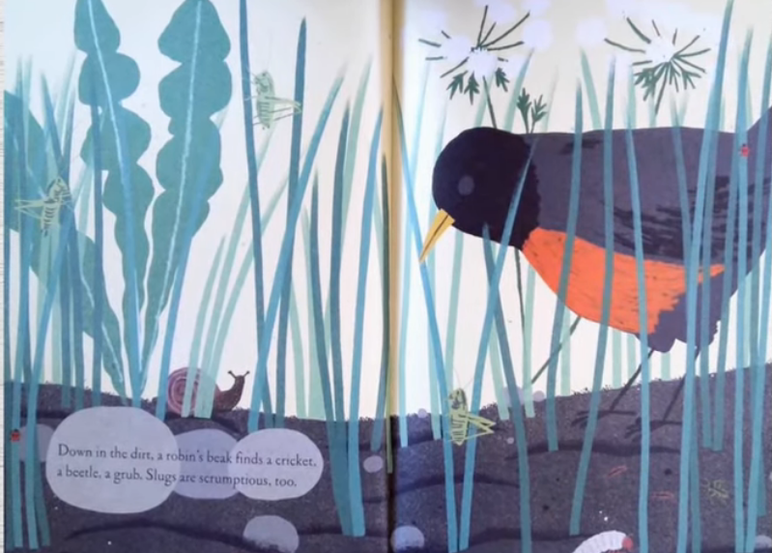
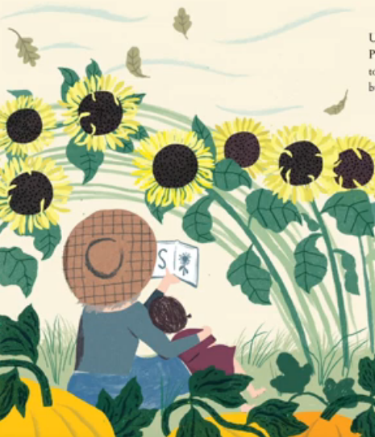
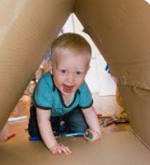
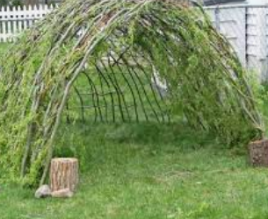
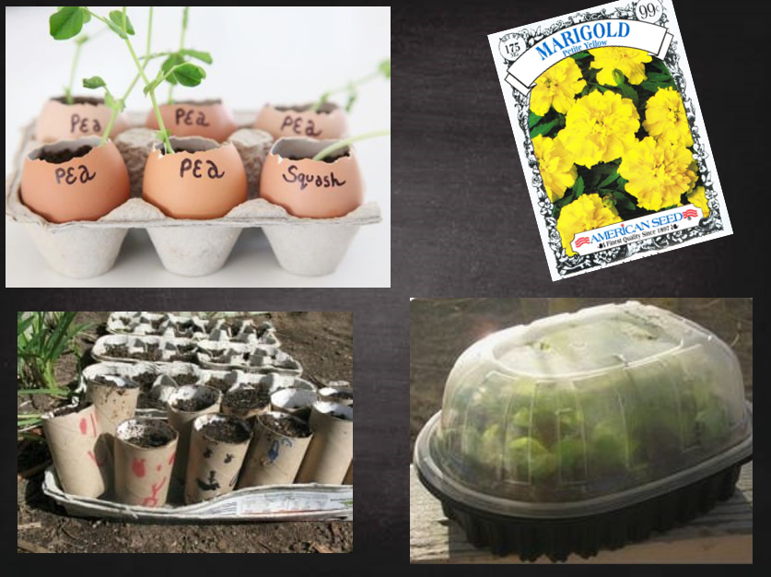
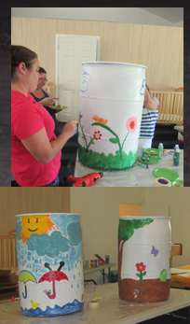
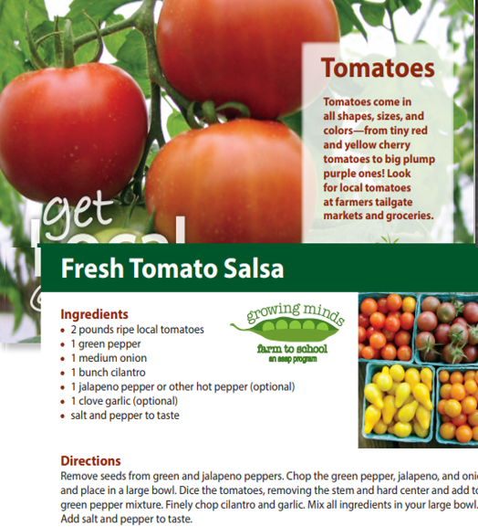
There is so much to discover as you explore the illustrations, “How many grasshoppers do you see? Let’s count them.” “How many bugs do you see?”, I see two lady bugs!”
The story also spans from daytime to nighttime. The sky changes from bright, to dark and as the seasons change the color scheme changes as well.
Have you ever made a living tunnel? This is a fun way to introduce spatial relations and positional words. Toddlers love exploring cozy nooks. What else could we use to make a special space? Indoors? Outdoors?
Every page inspires ways to engage children in nature play. Planting, watering, growing and harvesting flowers, vegetables and fruit. Explore inexpensive ways to start seeds. Instead of using a hose to water plants, you can decorate and install rain barrels. Using tools- wheelbarrows, pitch forks, baskets, nets, rakes for the leaves. Falling leaves can be collected and used to make collages, or just big piles to run and jump into. Try some new recipes! Even the glossary pages spark ideas for matching games and displays.
Up in the Garden and Down in the Dirt, Bu Kate Messner with art by Christopher Silas Neal. 2015

