Slide 1
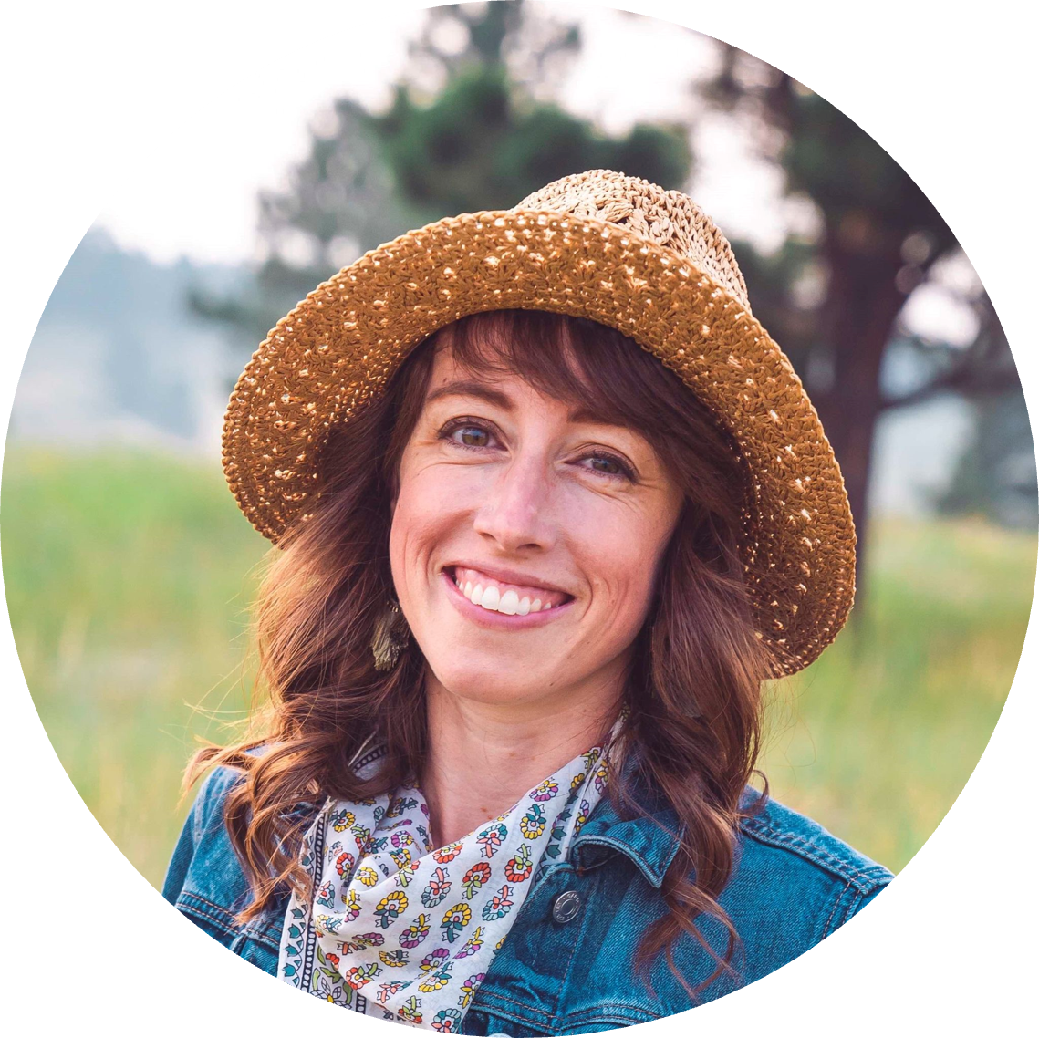
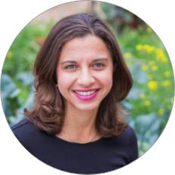
Molly Dailey
Sprouts Healthy Communities Foundation
Tristana Pirkl
SGSO Network

Slide 2
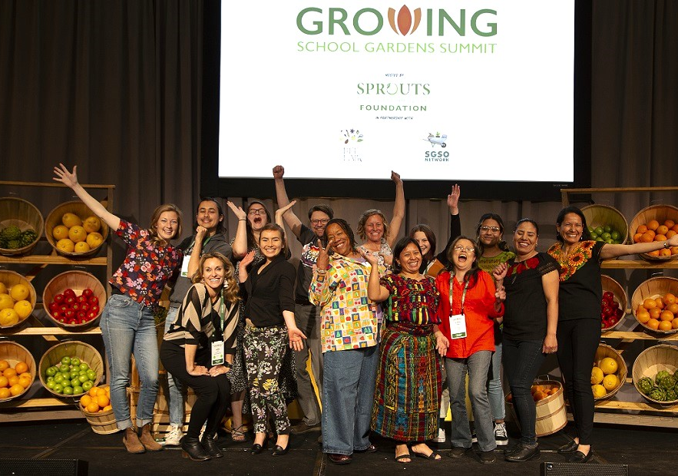
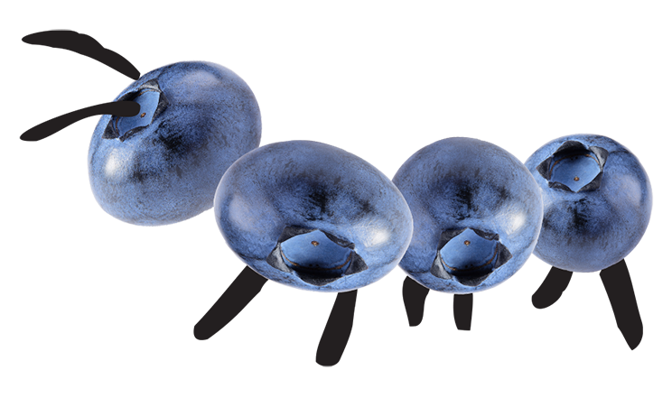
What is the Growing School Gardens Summit?
A gathering to inform, inspire and invigorate the school garden movement.
March 15-18, 2024
San Diego, CA
500+ School Garden Educators
100+ Education Sessions
Notes:
Who attends? School gardening support organizations (program managers, executive directors, curriculum developers, etc.), school district employees (school nutrition services teams, garden educators, garden program managers), young professionals starting in the field, and those looking to dive deeper into school gardening.

Slide 3
Hosts and Partners
Notes:
Life Lab is based in Santa Cruz, CA and seeks to cultivate children's love of learning, nutritious food, and nature through garden-based education. They operate school gardens and an educational space in Santa Cruz but also offer professional development and training opportunities for garden educators. With over 4 decades experience training school gardens educators, Life Lab is taking the lead on the overall agenda and educational opportunities at the Summit.
The SGSO Network is a peer-to-peer learning network for equitable garden-based education at school. We will be convening various networking opportunities at the Summit and will document and share the learning that takes place and provide space and support for continued collaboration following the Summit, including creation of peer learning communities and webinars highlighting speakers.

Slide 4
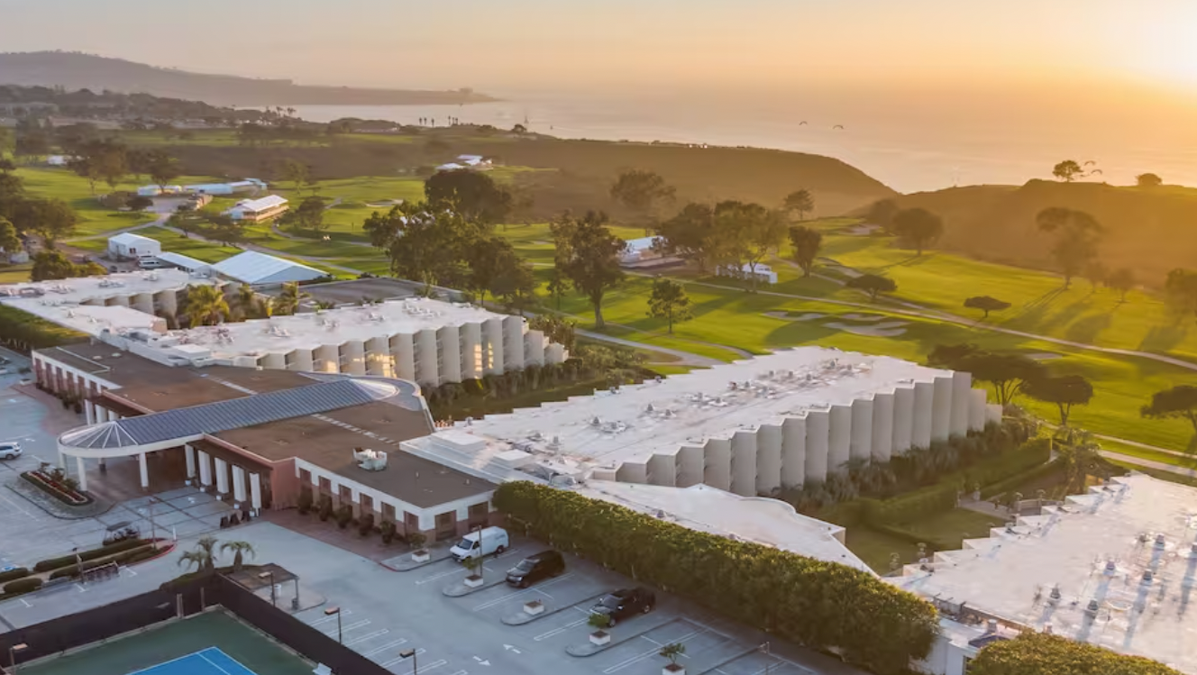
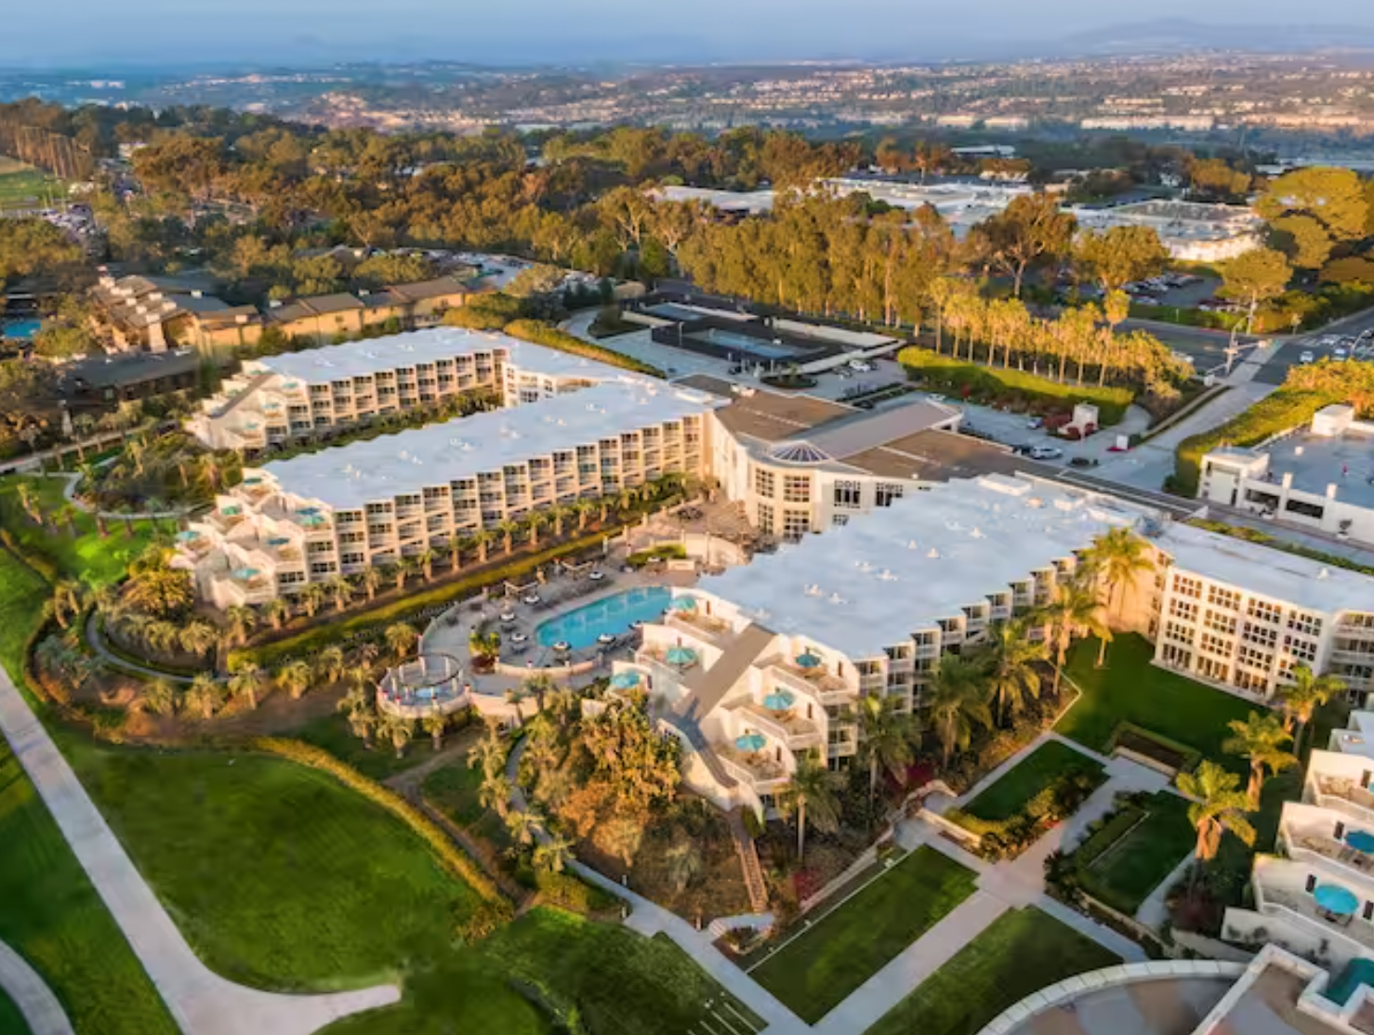
Dates, Location & Pricing
March 15-18, 2024
Hilton La Jolla Torrey Pines -
San Diego, CA
$450 Registration (Education + Meals)
$200 Room Cost per Night
(Singles or Doubles Available)

Slide 5
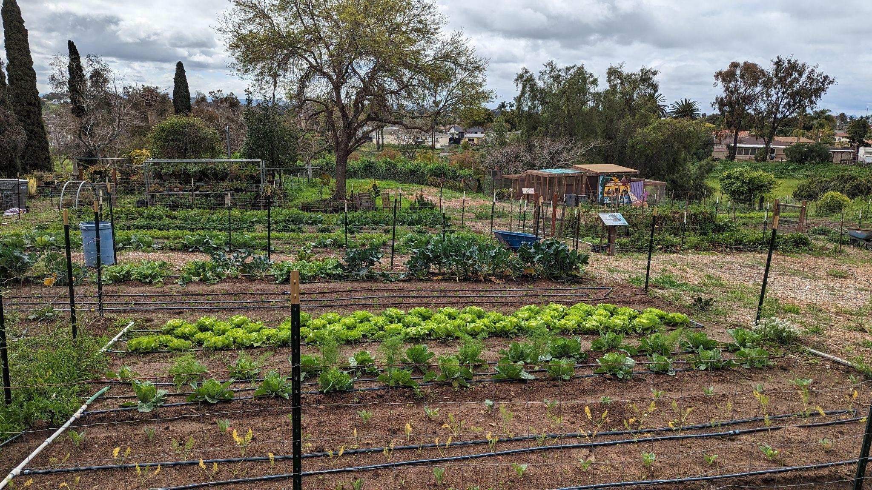
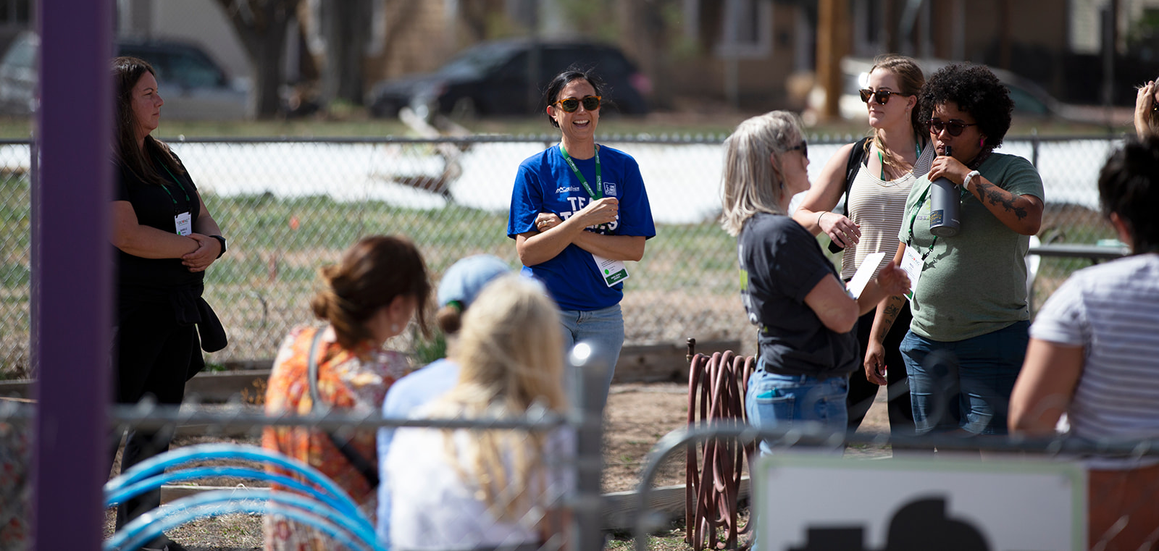
Field Trips + Short Courses
Field Trips at Six School Sites
300 Field Trip Spaces
Learn from top school gardening programs in Southern California
Eight Short Courses On-Site
200 Spaces
Deep-dive into topics, presented by subject matter experts

Slide 6
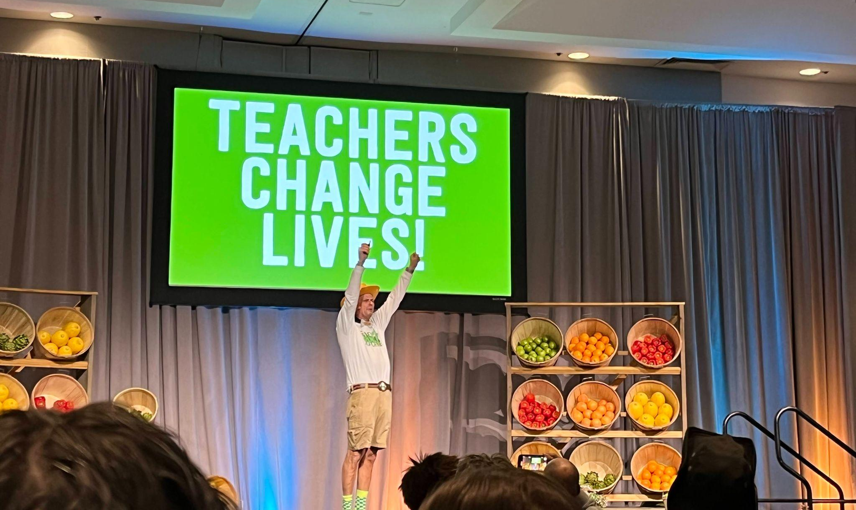
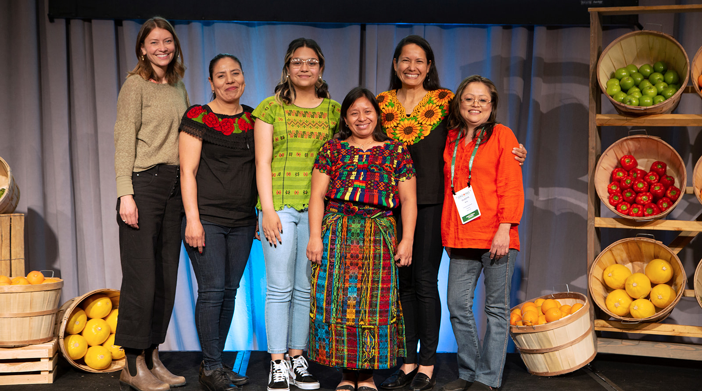
Main Stage Presenters & Keynote
Notes:
Speakers from across the country. Years of experience in school & community gardening. Diverse perspectives and backgrounds.
Featured Above Left to Right: Stephen Ritz (Green Bronx Machine - NYC), Dr. Dilafruz Williams (Portland State University - OR), Nathan Larson (Cultivate Health Initiative – WI), Veronica Gutierrez, Blanca Guerra and Eulalia Mateo (Commún - Denver, CO)

Slide 7
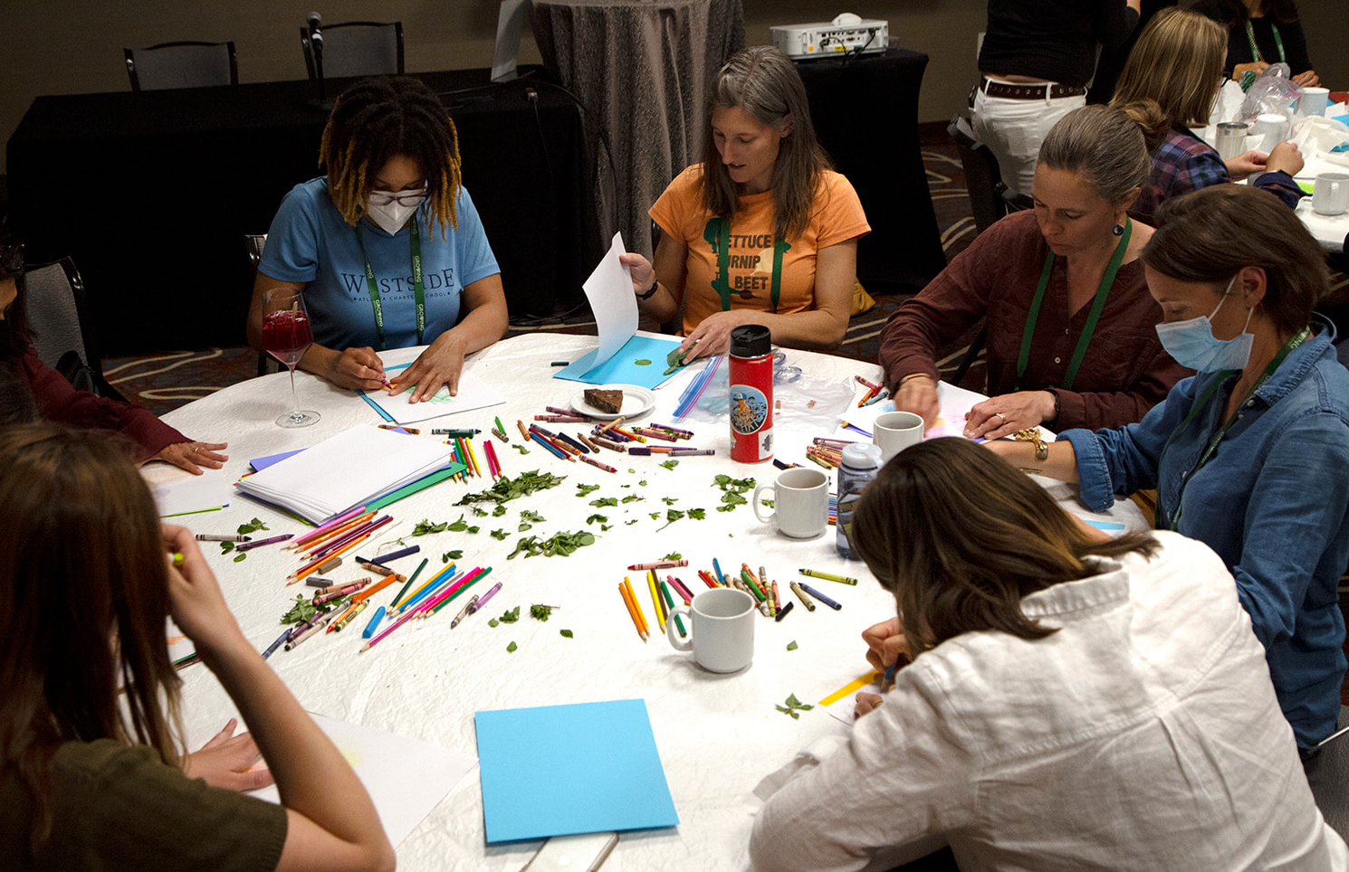
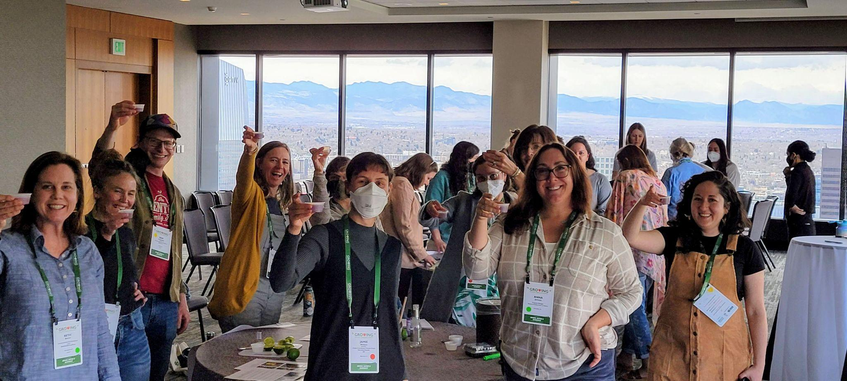
Workshops, Demos & More!
Indoor & Outdoor Presentations
Over 100 Sessions to Choose from!
Preview the agenda at: https://schoolgardensummit.org/summit-agenda-2024/
Notes:
We will have a mix of 60 min presentations, 75 min workshops diving deeper into a topic as well as indoor and outdoor hands on lesson demos - gardening and cooking demos. All of these presentations were selected by a diverse committee of folks across the country - you can find them here: https://schoolgardensummit.org/2024-planning-teams/
Preview the agenda but note that we are still identifying which sessions are on which days

Slide 8
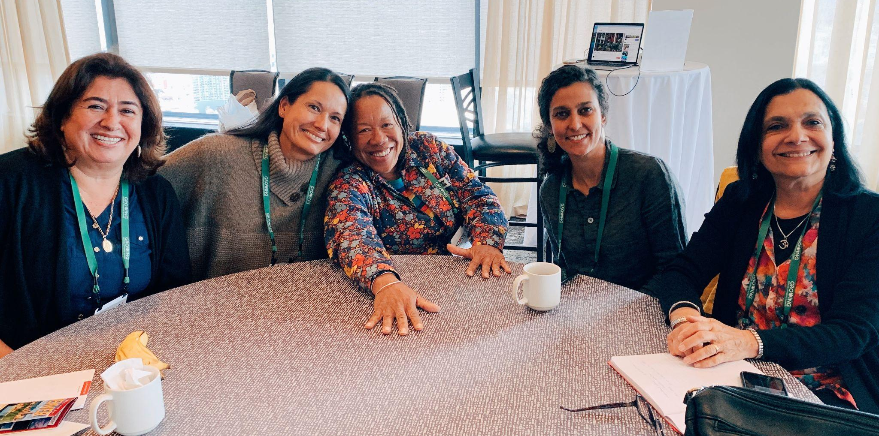
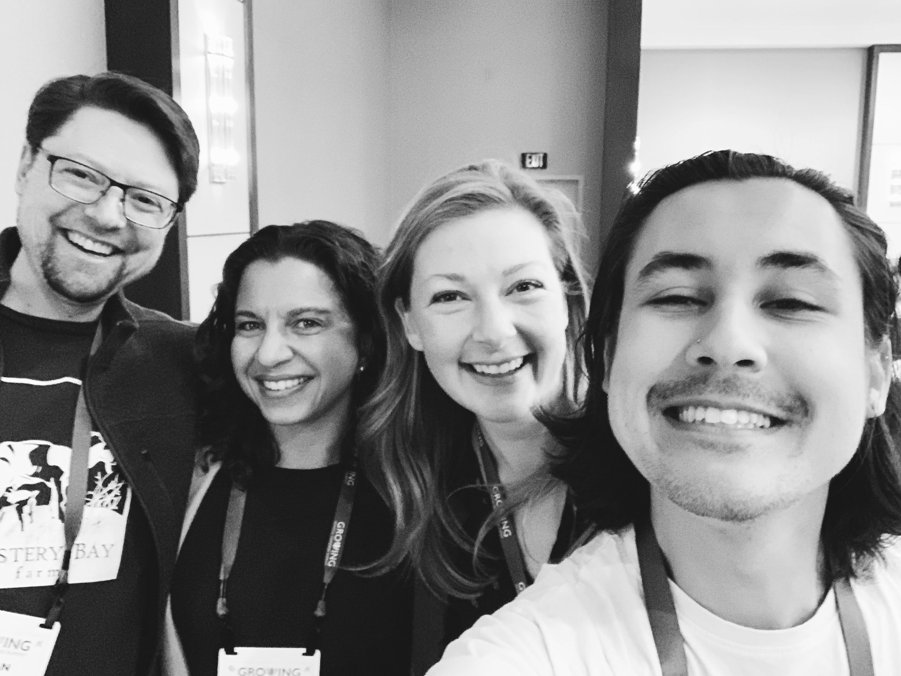
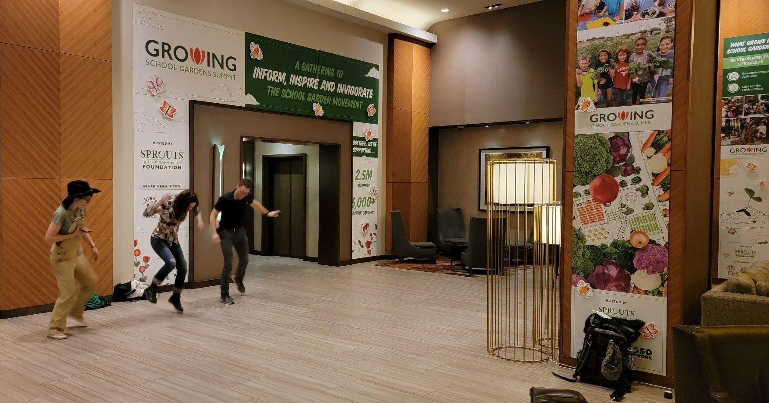
Networking & Having Fun
Notes:
-Opportunities to sit and network with people in your similar region and similar roles, such as garden educators, in-classroom teachers, principals, EDs, etc
-Designated time for affinity groups - gather based on your personal identity
-Opportunities for young professionals to find one another and get matched with a mentor
-Designated time for extracurricular activities including song circles, fire pit, arts and crafts, movement, board games and more.

Slide 9
SGSO Leadership Institute
Dates TBD -
Dec 2024 or Jan 2025
Notes:
This is an Institute hosted by Life Lab and WKF in partnership with the the SGSO Network for leaders of school garden support organizations - which we define as an entity that supports multiple school gardens.
24 organizations and 48 people
Life Lab opportunities: https://www.lifelab.org/sgso-institute
https://www.lifelab.org/professional-development

Slide 10
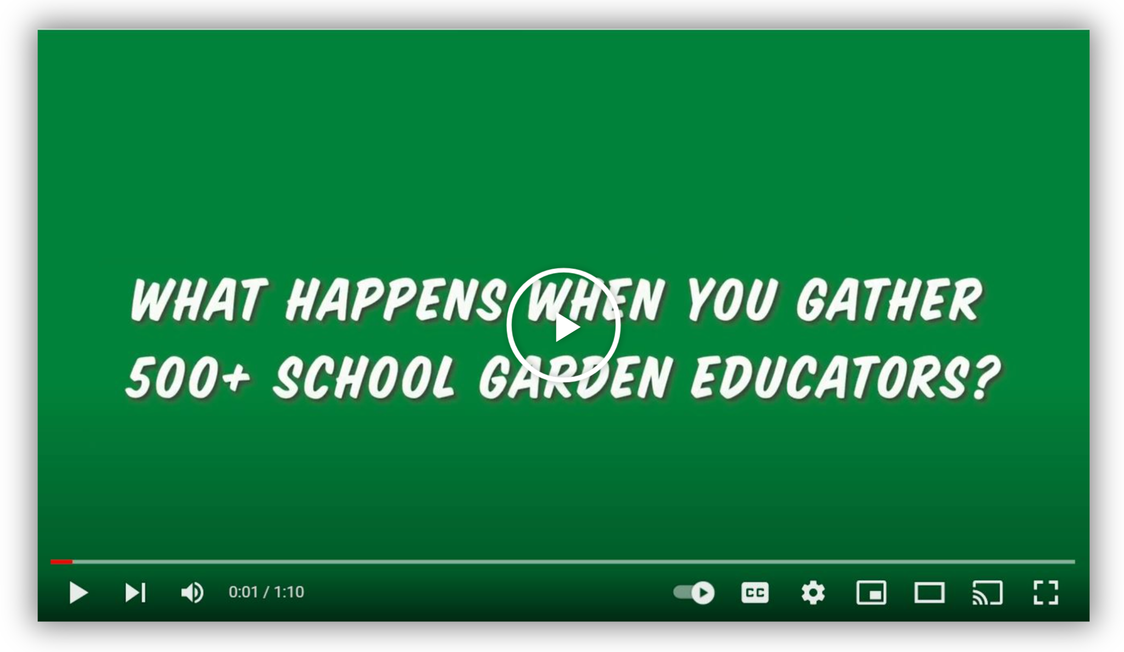
2024 Growing School Gardens Summit
Questions?
Email: Summit@sprouts.com
Learn More: schoolgardensummit.org
Watch this video to hear from 2022 attendees!

